Slide 1





Stacked Data Matrices Implementing the Generic Approach
Giuseppe Carteny
MZES, Universität Mannheim

Slide 2
List of Contents
Introduction
What is a Stacked Data Matrix (SDM)
The SDM in Electoral Analyses
The Basic Components
From Individual Observations to Dyads/Stacks
Generic Variables
Basic routine
Voter-Party Distances
Synthetic/Affinity Variables
An Overview of the Tutorial

Slide 3
Introduction
respid | age | LR respid | LR pos. Party A | LR pos. Party B | LR pos. Party C | LR dist. Party A | LR dist. Party B | LR dist. Party C | Vote Choice | PTV Party A | PTV Party B | PTV Party C
1 | 59 | 4 | 4 | 6 | 7 | 0 | 2 | 3 | A | 9 | 5 | 4
2 | 40 | 6 | 3 | 7 | 8 | 3 | 1 | 2 | B | 5 | 9 | 7
3 | 22 | 9 | 3 | 6 | 8 | 6 | 3 | 1 | C | 2 | 4 | 7
… | … | … | … | … | … | … | … | … | … | … | … | …
respid | party | age | LR dist. | Vote Choice | PTV
1 | A | 59 | 0 | 1 | 9
1 | B | 59 | 2 | 0 | 5
1 | C | 59 | 3 | 0 | 4
2 | A | 40 | 3 | 0 | 5
2 | B | 40 | 1 | 1 | 9
2 | C | 40 | 2 | 0 | 7
3 | A | 22 | 6 | 0 | 2
3 | B | 22 | 3 | 0 | 4
3 | C | 22 | 1 | 1 | 7
… | … | … | … | … | …
Readapted from van der Eijk et al. 2006

Slide 4
What is a SDM 1/2
It is a long-format data matrix, usually derived reshaping a wide-format data matrix:
Shift from an original data matrix (the wide-format one) with one row per observation to a new matrix in which each row represents a combination between the former original matrix observations (e.g., voters) and a second set of elements (e.g., parties);
Consequently, each new row is related to a dyadic relationship (also known as dyad or stack) between one element (e.g., the original data matrix observations) and another.

Slide 5
What is a SDM 2/2
The SDM allows for a generic approach that is based on a shift in both our analytical and conceptual levels
Downward in the level of analysis:
In electoral studies based on survey data: shift from the level at which preferences are gathered (individual) to the level at which preferences are formed (intra-individual).
Upward in the conceptual level:
In electoral studies based on survey data: shift from preferences conceived as referring to specific parties to preferences toward parties in general, or generic parties.

Slide 6
The SDM in Electoral Analyses 1/3
Contemporary representative democracies are characterized by a rather diverse set of party systems, mostly multiparty. This fact is problematic on several aspects when considering empirical comparative analysis.
Reductionist solutions:
Party system is reduced to a dichotomy (e.g., Government-Opposition) or positions on a single continuum (e.g., Left-Right);
However,…
IF we assume that the vote calculus, namely the process leading individuals’ voting behavior, is determined by, at least, (a) voters’ characteristics, (b) party characteristics, and (c) their relationship,
THEN explaining the vote calculus with a reductionist approach in settings that cannot be straight-forwardly reduced to a dichotomy or to a single dimension might be rather simplistic.
What is needed, then, is a generic solution.

Slide 7
The SDM in Electoral Analyses 2/3
Generic solutions’ aims:
Answer research questions concerning entire party systems, in each historical and national context under investigation or comparatively;
Maintain in the analyses all the (relevant) parties without arbitrarily reducing the party system (e.g., focusing solely on two major parties);
Keep all the features of each (relevant) party in a party system, without reducing the party system to a single property (e.g., party position of the Left-Right continuum);
In a comparative setting: (1) allow the pooling of data across party systems; (2) include in the analyses also macro-contextual characteristics, such as socio-structural factors, country-level institutional factors,...

Slide 8
The SDM in Electoral Analyses 3/3
The SDM, thus, is a generic solution for the analysis of voting behaviour
Focusing on the dyadic relationship between voters and (relevant) parties, it allows to (1) focus on vote calculus, (2) considering the main elements of this calculus (voters, parties, and their relationships), as well as (3) a variety of (generic) characteristics of the context in which this calculus is made.
With this shift in focus, analytical questions change:
from specific
e.g., “Which social class is most associated with vote for party X?”
to generic
e.g., “What is the importance of social class, compared to other characteristics, in making people vote for whichever of the available (relevant) parties?”

Slide 9
The Basic Components
respid | age | LR respid | LR pos. Party A | LR pos. Party B | LR pos. Party C | LR dist. Party A | LR dist. Party B | LR dist. Party C | Vote Choice | PTV Party A | PTV Party B | PTV Party C
1 | 59 | 4 | 4 | 6 | 7 | 0 | 2 | 3 | A | 9 | 5 | 4
2 | 40 | 6 | 3 | 7 | 8 | 3 | 1 | 2 | B | 5 | 9 | 7
3 | 22 | 9 | 3 | 6 | 8 | 6 | 3 | 1 | C | 2 | 4 | 7
… | … | … | … | … | … | … | … | … | … | … | … | …
respid | party | age | LR dist. | Vote Choice | PTV
1 | A | 59 | 0 | 1 | 9
1 | B | 59 | 2 | 0 | 5
1 | C | 59 | 3 | 0 | 4
2 | A | 40 | 3 | 0 | 5
2 | B | 40 | 1 | 1 | 9
2 | C | 40 | 2 | 0 | 7
3 | A | 22 | 6 | 0 | 2
3 | B | 22 | 3 | 0 | 4
3 | C | 22 | 1 | 1 | 7
… | … | … | … | … | …
Readapted from van der Eijk et al. 2006

Slide 10
The Basic Components From Individual Observations to Dyads
respid | age | LR respid | LR pos. Party A | LR pos. Party B | LR pos. Party C | LR dist. Party A | LR dist. Party B | LR dist. Party C | Vote Choice | PTV Party A | PTV Party B | PTV Party C
1 | 59 | 4 | 4 | 6 | 7 | 0 | 2 | 3 | A | 9 | 5 | 4
2 | 40 | 6 | 3 | 7 | 8 | 3 | 1 | 2 | B | 5 | 9 | 7
3 | 22 | 9 | 3 | 6 | 8 | 6 | 3 | 1 | C | 2 | 4 | 7
… | … | … | … | … | … | … | … | … | … | … | … | …
respid | party | age | LR dist. | Vote Choice | PTV
1 | A | 59 | 0 | 1 | 9
1 | B | 59 | 2 | 0 | 5
1 | C | 59 | 3 | 0 | 4
2 | A | 40 | 3 | 0 | 5
2 | B | 40 | 1 | 1 | 9
2 | C | 40 | 2 | 0 | 7
3 | A | 22 | 6 | 0 | 2
3 | B | 22 | 3 | 0 | 4
3 | C | 22 | 1 | 1 | 7
… | … | … | … | … | …
Readapted from van der Eijk et al. 2006

Slide 11
From Individual Observations to Dyads 1/3
The SDM allows for analysing relationships between two (sets of) elements, that we can define dyads or stacks:
Thus, the reshaping of the data matrix is conditional on the two sets of elements selected for creating a stack or dyad, let us say el1 and el2
In electoral analyses based on survey data:
Normally the first element of the dyad (el1) is almost given (e.g., A survey respondent unique identifier)
Consequently, the key passage in the construction of a SDM is usually related to the choice of the second set of element of the dyad (el2), for instance the relevant parties of the political context under investigation

Slide 12
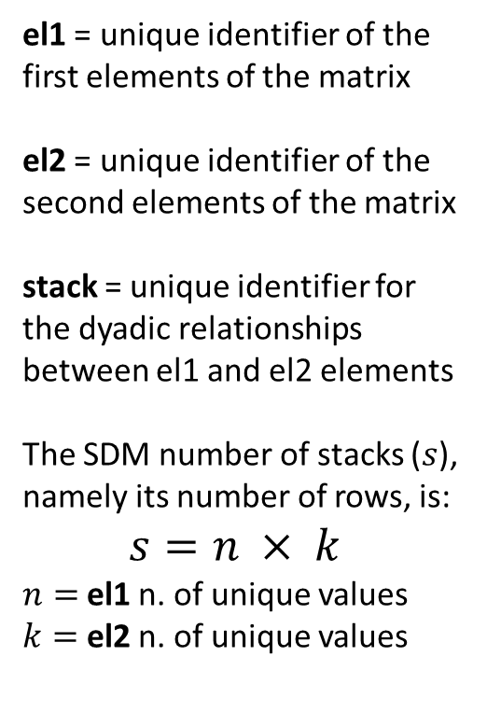
From Individual Observations to Dyads 2/3
el1
1
2
3
4
5
6
7
8
…
el2
A
B
C
el1 | el2
1 | A
1 | B
1 | C
2 | A
2 | B
2 | C
3 | A
3 | B
… | …
stack
1-A
1-B
1-C
2-A
2-B
2-C
3-A
3-B
…
el1 = unique identifier of the first elements of the matrix
el2 = unique identifier of the second elements of the matrix
stack = unique identifier for the dyadic relationships between el1 and el2 elements
The SDM number of stacks ($s$), namely its number of rows, is:
$$s=n × k$$
$n=$el1 n. of unique values
$k=$el2 n. of unique values

Slide 13
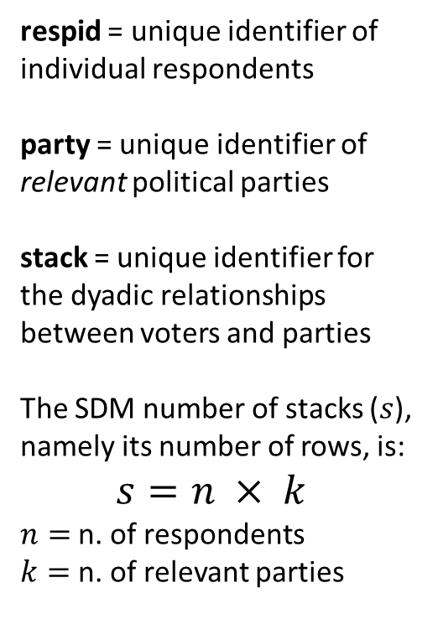
From Individual Observations to Dyads 3/3
respid
1
2
3
4
5
6
7
8
…
party
A
B
C
respid | party
1 | A
1 | B
1 | C
2 | A
2 | B
2 | C
3 | A
3 | B
… | …
stack
1-A
1-B
1-C
2-A
2-B
2-C
3-A
3-B
…
respid = unique identifier of individual respondents
party = unique identifier of relevant political parties
stack = unique identifier for the dyadic relationships between voters and parties
The SDM number of stacks ($s$), namely its number of rows, is:
$$s=n × k$$
$n=$n. of respondents
$k=$n. of relevant parties

Slide 14
The Basic Components Generic Variables
respid | age | LR respid | LR pos. Party A | LR pos. Party B | LR pos. Party C | LR dist. Party A | LR dist. Party B | LR dist. Party C | Vote Choice | PTV Party A | PTV Party B | PTV Party C
1 | 59 | 4 | 4 | 6 | 7 | 0 | 2 | 3 | A | 9 | 5 | 4
2 | 40 | 6 | 3 | 7 | 8 | 3 | 1 | 2 | B | 5 | 9 | 7
3 | 22 | 9 | 3 | 6 | 8 | 6 | 3 | 1 | C | 2 | 4 | 7
… | … | … | … | … | … | … | … | … | … | … | … | …
respid | party | age | LR dist. | Vote Choice | PTV
1 | A | 59 | 0 | 1 | 9
1 | B | 59 | 2 | 0 | 5
1 | C | 59 | 3 | 0 | 4
2 | A | 40 | 3 | 0 | 5
2 | B | 40 | 1 | 1 | 9
2 | C | 40 | 2 | 0 | 7
3 | A | 22 | 6 | 0 | 2
3 | B | 22 | 3 | 0 | 4
3 | C | 22 | 1 | 1 | 7
… | … | … | … | … | …
Readapted from van der Eijk et al. 2006

Slide 15
Generic Variables
The routines for creating generic variables for the SDM are rather similar and can be grouped according to several criteria
In the next slides we discuss about:
The stacking basic routine
The computation of voter-party distance (or proximity) variables
The estimation of synthetic/affinity variables

Slide 16
Generic Variables: Basic Routine 1/3
respid | votech
1 | A
2 | B
3 | C
4 | A
5 | B
6 | C
7 | A
8 | B
… | …
ptv_A
9
3
0
8
4
3
9
2
…
ptv_B
5
8
0
3
9
5
1
8
…
ptv_C
2
4
9
2
1
8
1
0
…
respid | party
1 | A
1 | B
1 | C
2 | A
2 | B
2 | C
3 | A
3 | B
3 | C
… | …
ptv
9
5
2
3
8
4
0
0
9
…
respid = unique identifier of individual respondents
ptv_X = respondents’ propensity to vote for party X
ptv = respondent propensity to vote for the stack party

Slide 17
Generic Variables: Basic Routine 2/3
respid | votech
1 | A
2 | B
3 | C
4 | A
5 | B
6 | C
7 | A
8 | B
… | …
votech_A
1
0
0
1
0
0
1
0
…
votech_B
0
1
0
0
1
0
0
1
…
votech_C
0
0
1
0
0
1
0
0
…
respid = unique identifier of individual respondents
votech_X = respondents’ self reported vote choice at a given election

Slide 18
Generic Variables: Basic Routine 3/3
respid | votech
1 | A
2 | B
3 | C
4 | A
5 | B
6 | C
7 | A
8 | B
… | …
votech_A
1
0
0
1
0
0
1
0
…
votech_B
0
1
0
0
1
0
0
1
…
votech_C
0
0
1
0
0
1
0
0
…
respid | party
1 | A
1 | B
1 | C
2 | A
2 | B
2 | C
3 | A
3 | B
3 | C
… | …
votech
1
0
0
0
1
0
0
0
1
…
respid = unique identifier of individual respondents
votech_X = respondents’ self reported vote choice at a given election
votech = indicates whether the respondent voted for the stack party

Slide 19
Generic Variables: Voter-Party Distances 1/3
respid | lrself
1 | 10
2 | 5
3 | 1
4 | 3
5 | 8
6 | 7
7 | 4
8 | 3
… | …
lr_A
9
8
9
7
9
9
7
8
…
lr_B
5
3
4
5
5
5
6
4
…
lr_C
1
0
1
2
0
1
2
0
…
respid = unique identifier of individual respondents
lrself = respondents’ Left-Right self placement
lr_x = respondents’ perceptions of party X position on the Left-Right dimension

Slide 20
Generic Variables: Voter-Party Distances 2/3
respid | lrself
1 | 10
2 | 5
3 | 1
4 | 3
5 | 8
6 | 7
7 | 4
8 | 3
… | …
lr_A
9
8
9
7
9
9
7
8
…
lr_B
5
3
4
5
5
5
6
4
…
lr_C
1
0
1
2
0
1
2
0
…
dist_A
1
3
8
4
1
2
3
5
…
dist_B
5
2
3
2
3
2
2
1
…
dist_C
9
5
0
1
8
6
2
3
…

Slide 21
Generic Variables: Voter-Party Distances 3/3
respid | lrself
1 | 10
2 | 5
3 | 1
… | …
lr_A
9
8
9
…
lr_B
5
3
4
…
lr_C
1
0
1
…
dist_A
1
3
8
…
dist_B
5
2
3
…
dist_C
9
5
0
…
respid | party
1 | A
1 | B
1 | C
2 | A
2 | B
2 | C
3 | A
3 | B
3 | C
… | …
lrself
10
10
10
5
5
5
1
1
1
…
lr_prty
9
5
1
8
3
0
9
4
1
…
lr_dist
1
5
9
3
2
5
8
3
0
…
respid = unique identifier of individual respondents
lrself = respondents’ Left-Right self placement
lr_prty = respondents’ perceptions of the stack party position on the Left-Right dimension
lr_dist = distance between respondent and the stack party on the Left-Right continuum

Slide 22
Generic Variables: Synthetic 1/4
synthetic variables (aka “y-hats”) are predictions of regression models, measuring the affinity between the individual respondents’ and the stack parties on the basis of a set of individual variables
For estimating these y-hats we need to:
define a dependent variable (say, propensity to vote for party X)
select the predictors of said models (say, respondents’ socio-demographic characteristics)
fit the proper regression model for each relevant party and compute the predicted scores for each respondent.

Slide 23
Generic Variables: Synthetic 2/4
respid | age
1 | 76
2 | 25
3 | 54
4 | 41
5 | 64
6 | 23
7 | 36
8 | 50
… | …
ptv_A
9
3
0
8
4
3
9
2
…
ptv_B
5
8
0
3
9
5
1
8
…
ptv_C
2
4
9
2
1
8
1
0
…
respid = unique identifier of individual respondents
age = respondent’s age
ptv_X = respondents’ propensity to vote for party X
ptv = respondent propensity to vote for the stack party

Slide 24
Generic Variables: Synthetic 3/4
respid | age
1 | 76
2 | 25
3 | 54
4 | 41
5 | 64
6 | 23
7 | 36
8 | 50
… | …
ptv_A
9
3
0
8
4
3
9
2
…
ptv_B
5
8
0
3
9
5
1
8
…
ptv_C
2
4
9
2
1
8
1
0
…
yhat_A
8.8
2.9
0.1
7.6
4.2
2.6
8.5
2.1
…
yhat_B
5.2
8.1
0.5
3.2
9.7
4.8
1.2
8.1
…
yhat_C
2.1
4.3
8.5
1.6
1.2
8.4
1.1
0.3
…

Slide 25
Generic Variables: Synthetic 4/4
respid | age
1 | 76
2 | 25
3 | 54
… | …
ptv_A
9
3
0
…
ptv_B
5
8
0
…
ptv_C
2
4
9
…
yhat_A
8.8
2.9
0.1
…
yhat_B
5.2
8.1
0.5
…
yhat_C
2.1
4.3
8.5
…
respid | party
1 | A
1 | B
1 | C
2 | A
2 | B
2 | C
3 | A
3 | B
3 | C
… | …
age
76
76
76
5
5
5
1
1
1
…
ptv
9
5
2
3
8
4
0
0
9
…
yhat
8.8
5.2
2.1
3
2
5
8
3
0
…
respid = unique identifier of individual respondents
age = respondent’s age
ptv = respondent’s propensity to vote for the stack party
yhat = impact of socio-demographic variables (age) on respondent’s propensity to vote for the stack party

Slide 26
Overview of the Tutorial
respid | age | LR respid | LR pos. Party A | LR pos. Party B | LR pos. Party C | LR dist. Party A | LR dist. Party B | LR dist. Party C | Vote Choice | PTV Party A | PTV Party B | PTV Party C
1 | 59 | 4 | 4 | 6 | 7 | 0 | 2 | 3 | A | 9 | 5 | 4
2 | 40 | 6 | 3 | 7 | 8 | 3 | 1 | 2 | B | 5 | 9 | 7
3 | 22 | 9 | 3 | 6 | 8 | 6 | 3 | 1 | C | 2 | 4 | 7
… | … | … | … | … | … | … | … | … | … | … | … | …
respid | party | age | LR dist. | Vote Choice | PTV
1 | A | 59 | 0 | 1 | 9
1 | B | 59 | 2 | 0 | 5
1 | C | 59 | 3 | 0 | 4
2 | A | 40 | 3 | 0 | 5
2 | B | 40 | 1 | 1 | 9
2 | C | 40 | 2 | 0 | 7
3 | A | 22 | 6 | 0 | 2
3 | B | 22 | 3 | 0 | 4
3 | C | 22 | 1 | 1 | 7
… | … | … | … | … | …
Readapted from van der Eijk et al. 2006

Slide 27
Tutorial
It is a walkthrough of the scripts for creating a SDM of the EES Italian voter study of 2019
Different workflows can be followed for creating a SDM, but two main strategies:
Mutate the relevant variables => Stack the original matrix
Stack the original matrix => Mutate the relevant variables
In both R and Stata scripts the first strategy is used

Slide 28
Thank you for your attention!

